Slide 1
FO Modules
Introduction to the Viewer

Slide 2
Learning Objectives
Introduction to the Viewer
At the end of this course, you will be able to:
Explain the purpose and features of the Viewer.
Customize an MXpress view and layout.
Notes:
Always start with a verb: see Bloom’s taxonomy for reference

Slide 3
Introduction to the Viewer?
Agenda
View Customization

Slide 4
Introduction to the viewer
What is the Viewer?
Where is the Viewer used?
What are the basic components of the Viewer?
Viewer components
Single View components
Edit View mode
Edit Layout mode
Hands on

Slide 5
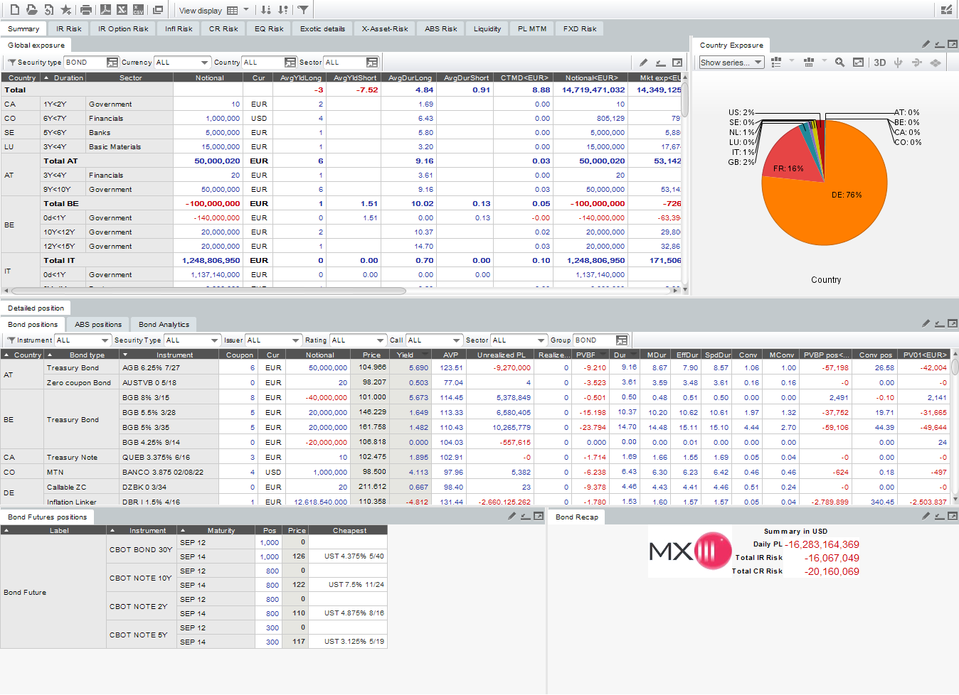
Introduction to the Viewer
What is the Viewer? (1/3)
The Viewer is an interactive data visualization tool used in main MX.3 business screens.
Notes:
Trainer start by mentioning some business scenarios where we may need to use the flowTrigger.

Slide 6
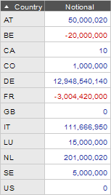
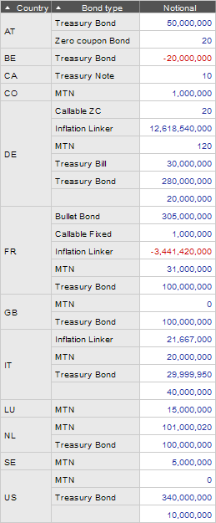
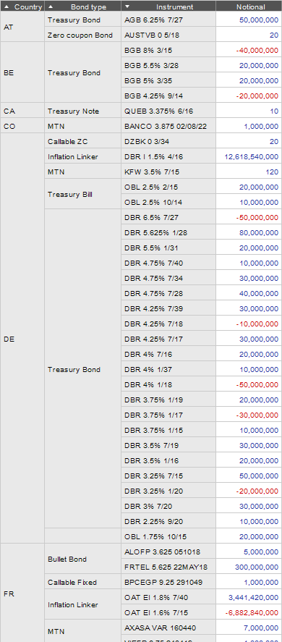
Introduction to the Viewer
What is the Viewer? (2/3)
It displays aggregated results with possibility to drill down on details.

Slide 7
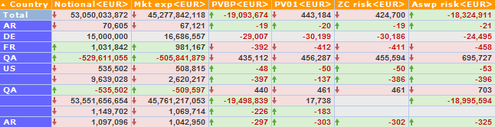
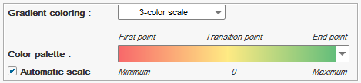
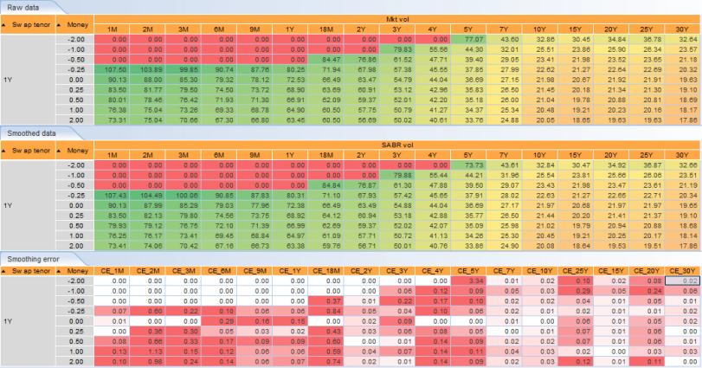
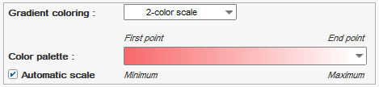
Introduction to the Viewer
What is the Viewer? (3/3)
It offers many customization tools: format, user actions, calculation settings…

Slide 8
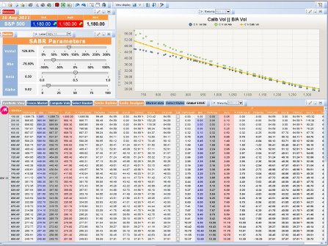
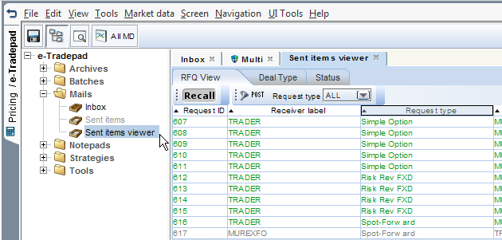
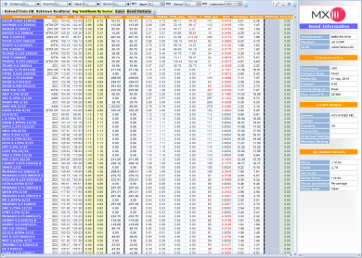
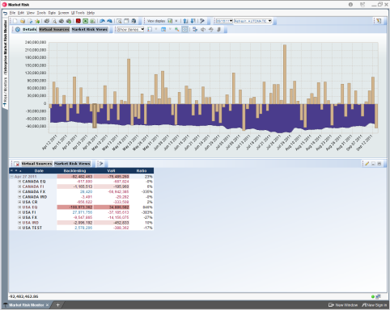
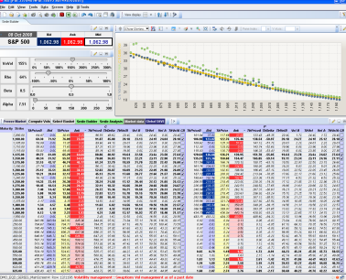
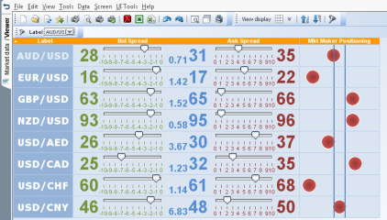
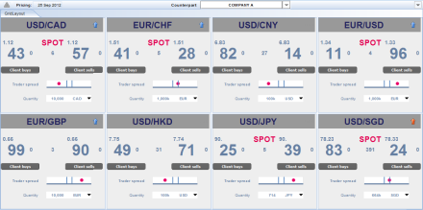
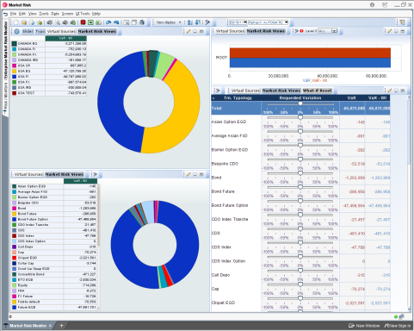
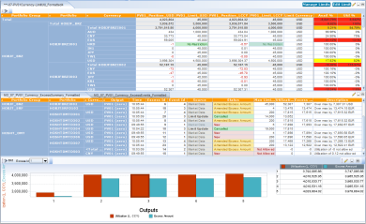
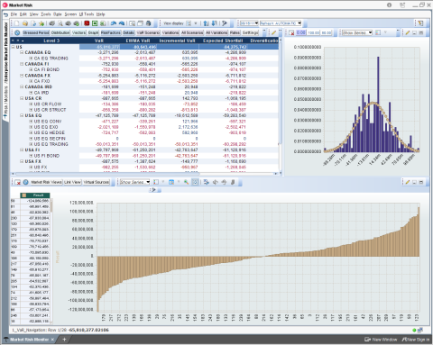
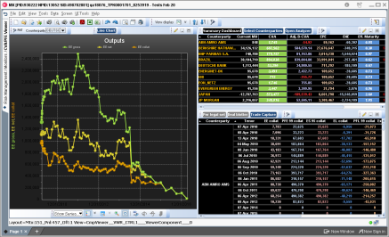
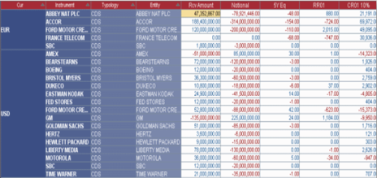


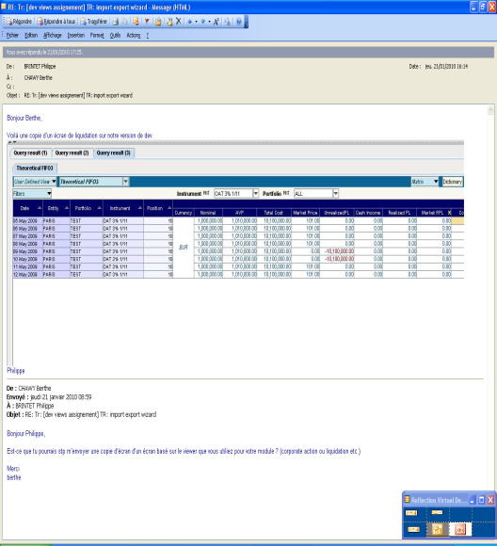
Introduction to the Viewer
Where is the Viewer used?
Volatility Management
RFQ
Real-time Position & Limits Management
Enterprise Market Risk Monitor
Market Data
Pricing Matrix
Real-time Excess Monitoring
Counterparty Risk
Revaluation and Display
Datamart
Revaluation
and Storage
DATAMART
CALCULATION
ENGINE
Formatted Excel
Downstream System
or 3rd party Reporting Tool
PDF report
Flat File
Browser Screens
MX
FINANCIAL

Slide 9
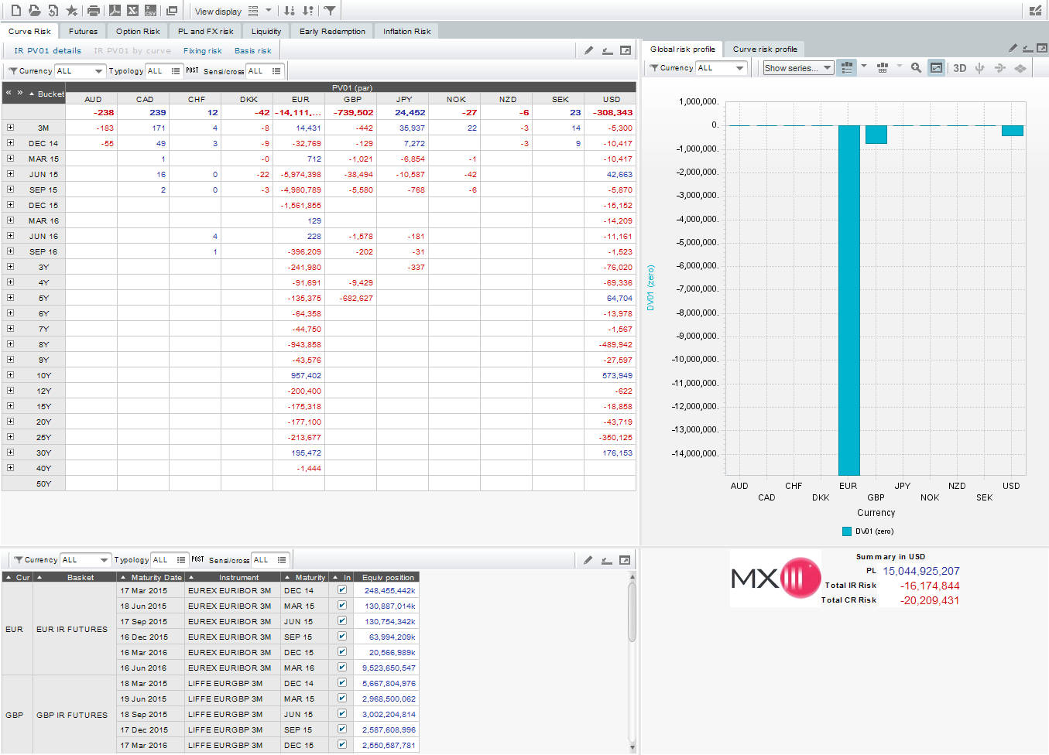
What are the Viewer components?

Slide 10
What are the Viewer components?
Layout

Slide 11
What are the Viewer components?
View tabs
subtitle
Tree view
Chart view
Grid view
Form view

Slide 12
What are the Viewer components?
Standard toolbar
for standard actions
(New, Reload, Print, …)
View display toolbar
(change display type, sort, filter)
a

Slide 13
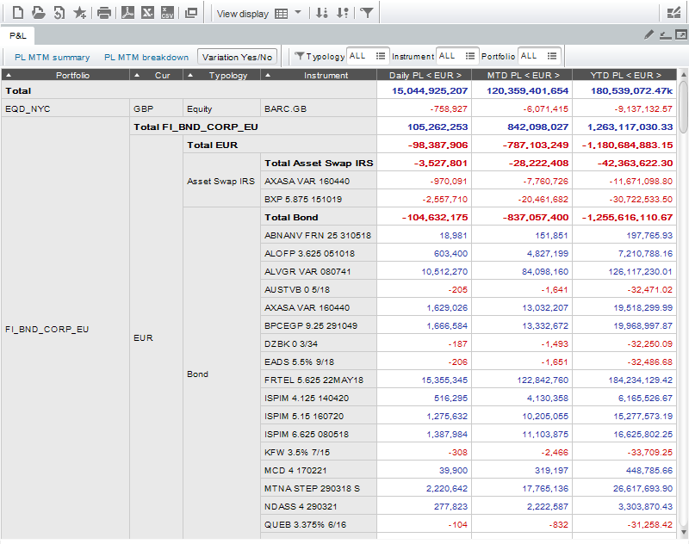
What are the Viewer components?
Single View Components

Slide 14
What are the Viewer components?
Single View Components
Breakdown area
Output area

Slide 15
What are the Viewer components?
View title
Single View Components
Action toolbar: contains user-defined action buttons that trigger specific commands.
Filter toolbar

Slide 16
What are the Viewer components?
Single View Components
Edit view and Edit layout buttons
(more on this in the next slide!)

Slide 17
What are the Viewer components?
Use mode versus Edit modes
The Viewer has three operation modes:
Use (default mode)
Restricted to navigation, filtering, sorting and business-related actions.
Edit View
Zoom and design one view at a time.
Edit Layout
Shape the views arrangement (split the screen, add new views, reorder views position in the screen).

Slide 18
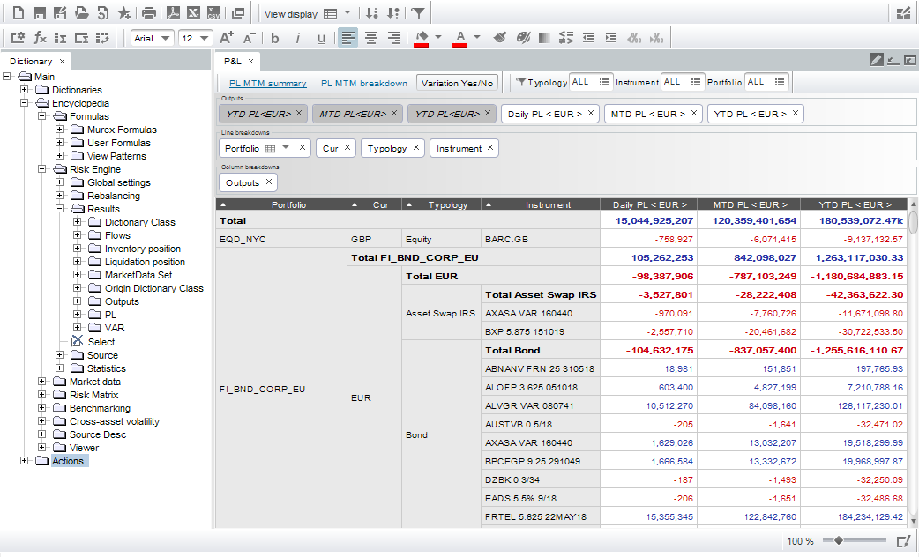
What are the Viewer components?
Edit View Mode

Slide 19
What are the Viewer components?
Edit View Mode
Format toolbar
View design toolbar
Dictionary: list of data fields
View fields
Preview

Slide 20
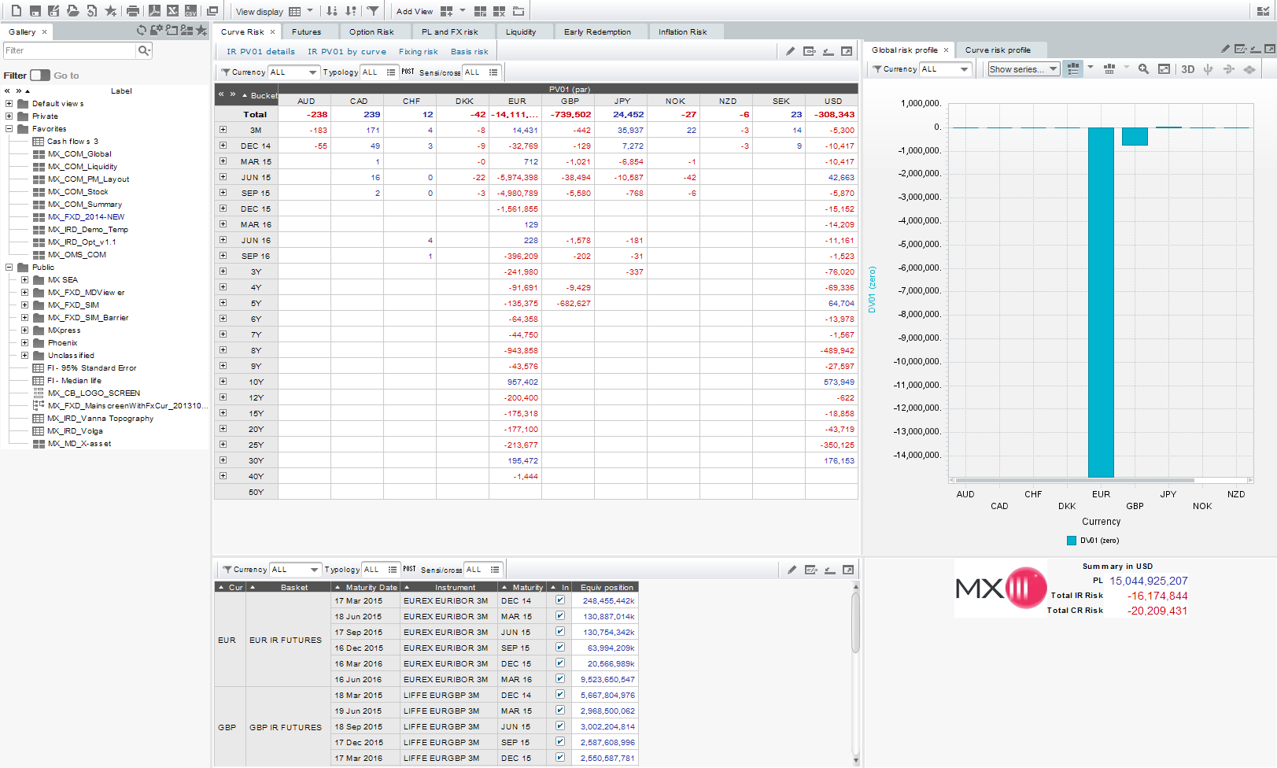
What are the Viewer components?
Edit Layout Mode

Slide 21
What are the Viewer components?
Edit Layout Mode
Gallery: list of views and layouts
Layout design toolbar: split the screen into tabs and panels

Slide 22
Introduction to the Viewer
Introduction to the Viewer
Manipulate a view.
Log into MX with user MUREXFO/MUREXFO.
Select the group FO.
Load a consolidated simulation (by position) on portfolio FI_BND_ALL.
Split the “PL breakdown” tab horizontally.
Rename the tab “PL MTM”.
Add the view “MX_PL_MTM summary (c)” to the bottom of the tab.
Add the field “Risk Engine.Results.PL.P&L (Abs).Cash/MV” to the outputs of the view “MX_PL_MTM summary (c)”.
Change its view display to Tree.
Save the layout as “<your name>_BOND”.

Slide 23
Introduction to the Viewer?
Agenda
View Customization

Slide 24
View Customization
Filters
Pre-filters
Post-filters
Differences
Field settings
Format
Viewer actions

Slide 25
View Customization
Comparison between Pre-filters and Post-filters
Pre-filters (data source filters)
Post-filters (ad hoc filters)
Pre-filters (data source filters) | Post-filters (ad hoc filters)
Filter out data from the data source, before the view is built. | Hide or show rows of data, after the view is built.
Limited to non-calculated fields. | Can be applied on any fields displayed in the view (calculated fields, totals and formulas).
Accelerate initial load and market data refresh. Changing a pre-filter value is not very fast, because it rebuilds the view. | Do not accelerate initial load nor market data refresh. Changing a post-filter value is fast.
Should be pre-configured and hidden. Not meant to be modified by the user. | Can be added and used on the fly by the user.
Impact totals. | By default, do not impact totals. Setting available to impact totals: View Format > Post filters : display like pre filters
Data
Pre
Build
Post
Client
Data
Pre
Build
Post
Client

Slide 26
View Customization
Practice 2: Filters
Add filters and observe difference between pre and post filters.
In the bottom view of the “Bond and Futures position” tab, remove the filters “Security Type” and “Typology”.
Add a pre-filter and a post-filter on the field “Sec code”.
Display these filters as combo boxes.
With the pre-filter: filter on a single Sec code, then filter on ALL Sec code.
Do the same with the post-filter and notice the difference in performance.
Notes:
Exercise is guided but more hands-on than a Practice.
Trainer gives short introduction of exercise

Slide 27
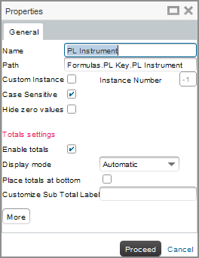
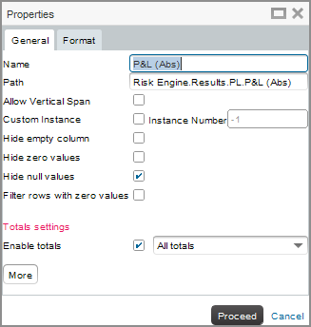
View Customization
Generic Viewer Properties
In Edit view mode, right click > Properties
These settings are common to all fields.
Breakdown properties
Output properties

Slide 28
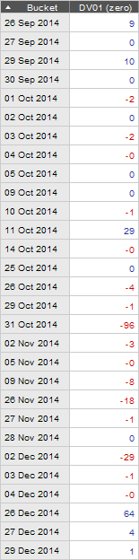
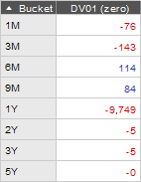
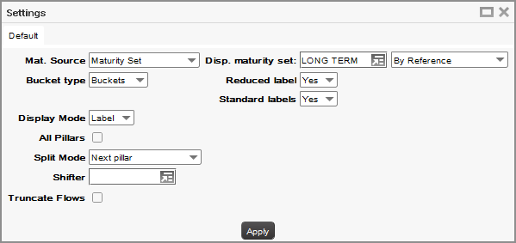
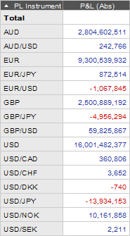
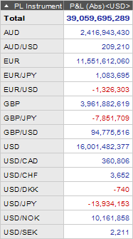
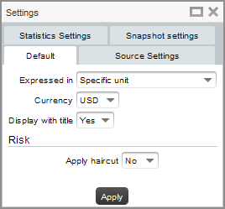
View Customization
Specific FO Settings
In Edit view mode, right click > Breakdown settings… or right click > Output settings…
These settings are specific to the field and to the context (e.g. Simulation).
Set date fields to bucketed/pillar set mode:
Convert values to a specific currency:

Slide 29
View Customization
Practice 3: FO Settings
Customize a view.
In the top view of the “Bond and Futures position” tab, change the “Duration” display to “All data” instead of buckets.
Change the “Notional<USD>” currency to EUR instead of USD.

Slide 30
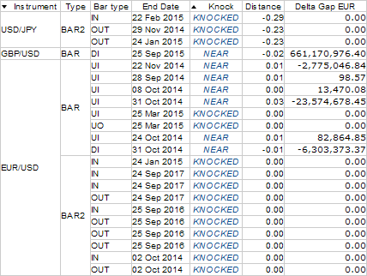
View Customization
Format
Field Format
View Format
Conditional Format
Default format
Change the appearance of your view with Formatting.

Slide 31
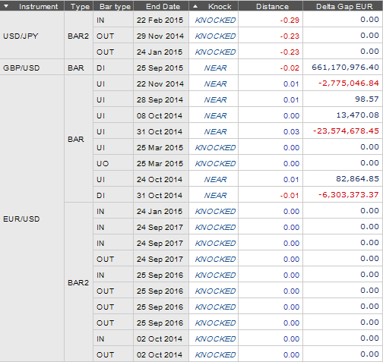
View Customization
View Format
Field Format
View Format
Conditional Format
Applies to all fields in the view:
Font size
Cell colors
Action button format…
View format

Slide 32
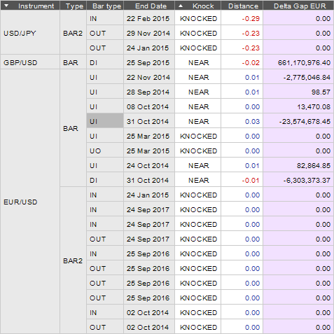
View Customization
Field Format
Field Format
View Format
Conditional Format
Applies to individual fields:
Highlight color
Number of decimals
...
Field format

Slide 33
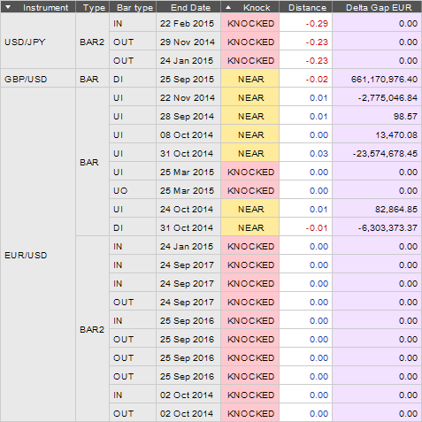
View Customization
Conditional Format
Field Format
View Format
Conditional Format
Format based on a condition, e.g.: knocked barriers become red, etc.
Conditional format

Slide 34
View Customization
Practice 4: Formatting
Modify View formats.
The MXpress formatting template should be already unzipped in the cfg folder of your client directory.
Reset all field formatting from your view.
Import and apply the template to your view.
Highlight an output by setting its background color to RGB(242,225,255).

Slide 35
Viewer Actions
Actions are buttons or links that can be added to a view.
They have various effects:
Viewer-specific actions (open a new view, input parameter…)
Functional actions (build a smile, insert what-if orders…)

Slide 36
View Customization
Practice 5: Actions
Create a new action in a view.
Add a view action button to the “MX_PL_MTM summary (c)” view (dictionary path: Actions.Default Actions.View).
Configure the new action to open the “MX_BOND_Position” view in a new window.

Slide 37
Appendix
Viewer e-learning
Viewer documentation
Viewer features
MXpress views

Slide 38
Viewer Documentation
Doc title | Doc ID | Preview
Viewer FAQ | 12074 | Short questions & answers on the viewer, related to installation, upgrade, layout & view construction, menus, use & design modes, find & filter, toolbars, data display, printing and rights management.
MX Viewer Technical guide | 7037 | Detailed technical doc on the viewer features and settings, Getting started with the viewer
Data Visualization Catalog | 19521 | Description of the available charts in MX in order to make users aware of the many possibilities of data visualization in the Viewer and help them find the most appropriate representation for their data.
Import and Export of Viewer Objects | 14366 | Viewer import/export through the Import/export wizard
Views & Layouts assignment | 10302 | General views & layout assignment (excluding Simulation views)
Simulation screen assignments | 12990 | Simulation views & layout assignment
Linked views | 17066 | How to create linked views
Viewer Rights management | 17065 | How to set rights on views at view level or using Rights tempaltes
Viewer Forms | 16545 | How to design forms
Viewer 3D Charts | 17747 | How to set up a view in 3D
Viewer Data Export & Printing | 17100 | How to export data to Excel, CSV, PDF or send it to a printer
Doc title
Doc ID
Preview

Slide 39
Viewer Features
Data Selection
Comprehensive Data Dictionary
Comprehensive Data Dictionary | Choose the data fields to feed your view from the data dictionary.
Breakdown Grouping and Columns Arrangement | Group your data fields by adding, reordering, hiding columns.
Aggregated Calculations | Display summed totals, average or standard deviation for each grouping level.

Slide 40
Viewer Features
Data Display
Layout Organization | Split the screen into different panels and tabs to design the most efficient data dashboard.
Cells Format | Resize cells, set their background/foreground/border colors, choose the text font and alignment.
Conditional Format | Update the cells format depending on a certain condition.
Wide Range of Data Visualization Types | Choose the best suited data visualization type to display your data (grids, charts…).

Slide 41
Viewer Features
Data Interaction
Drill-down Navigation | Expand/Collapse nodes to investigate data in increasing detail.
Filtering and Sorting | Individual or shared filters across views. Absolute sorting or within grouping levels.
User-defined Actions | Add action buttons to trigger specific commands.

Slide 42
Viewer Features
Other Distinctive Features
View and Layout Assignment | Assign a default view or layout to load automatically for particular users.
Reusable Objects | Viewer objects can be exported and reused in different environments (formatting templates, view an layout definitions, gallery organization…).
Exportable Data | Data can be exported to CSV, Excel and PDF files.

Slide 43
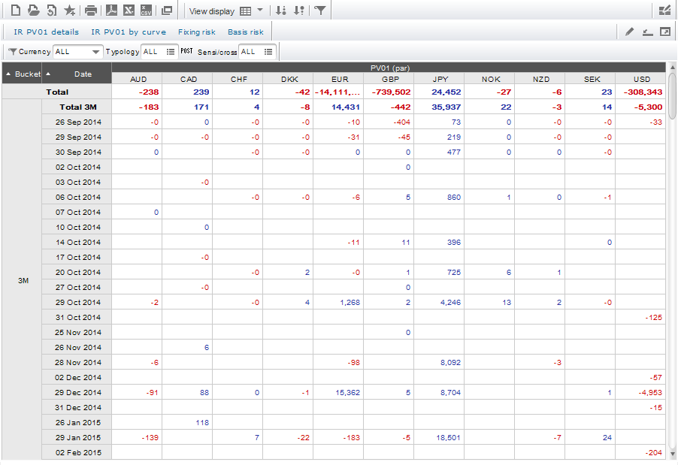
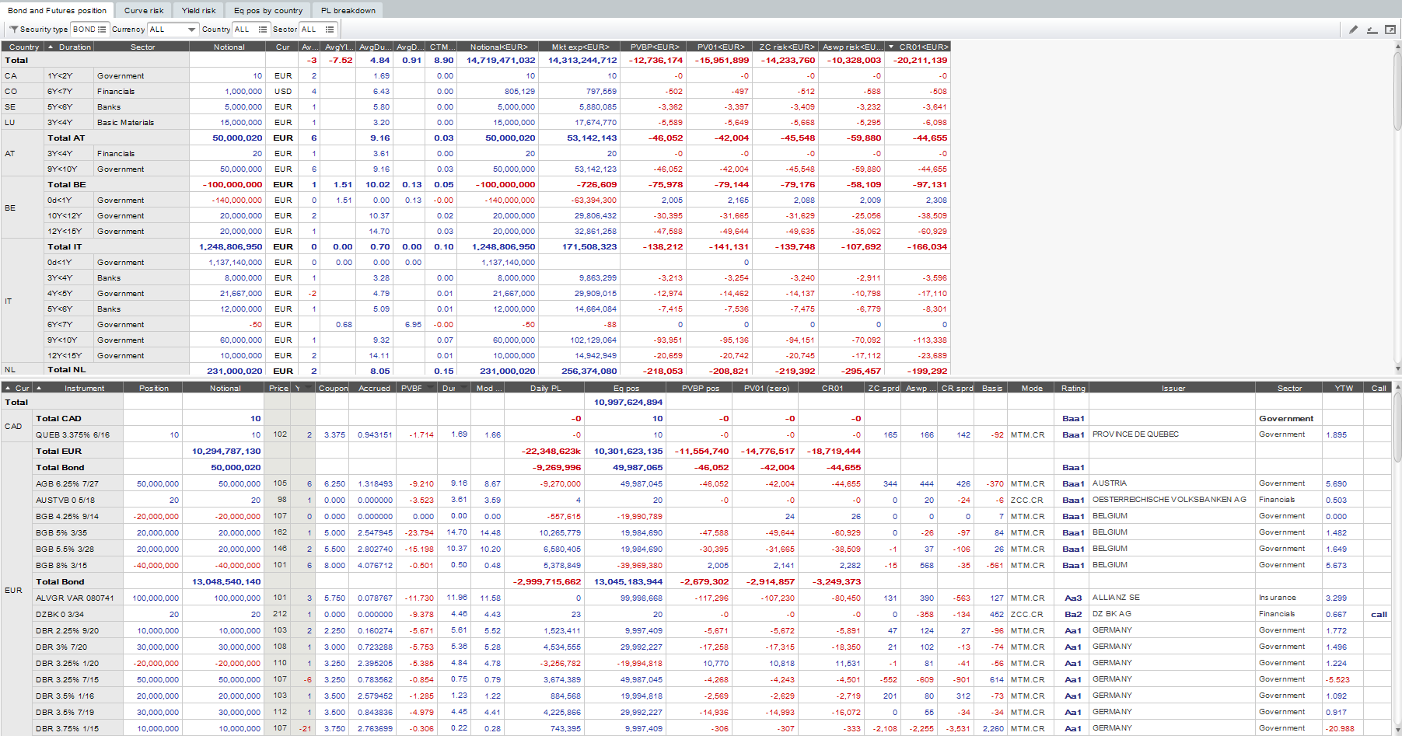
MXpress Views
The MXpress package is a set of out-of-the-box views.
Use MXpress preconfigured views as a building base to get recommended Viewer settings.
The following list is a sample of MXpress views categories.
P&L, liquidity, e-Tradepad blotter for all assets
IRD blotter, PV01, position
CRD blotter, CR01 risk and exposure
EQD sensitivities and risk
FXMM position, blotter, trade contribution
Security finance inventory, delivery
COM risk and hedge position
FXD risk and position

Slide 44
Thank you!

